Slide 1
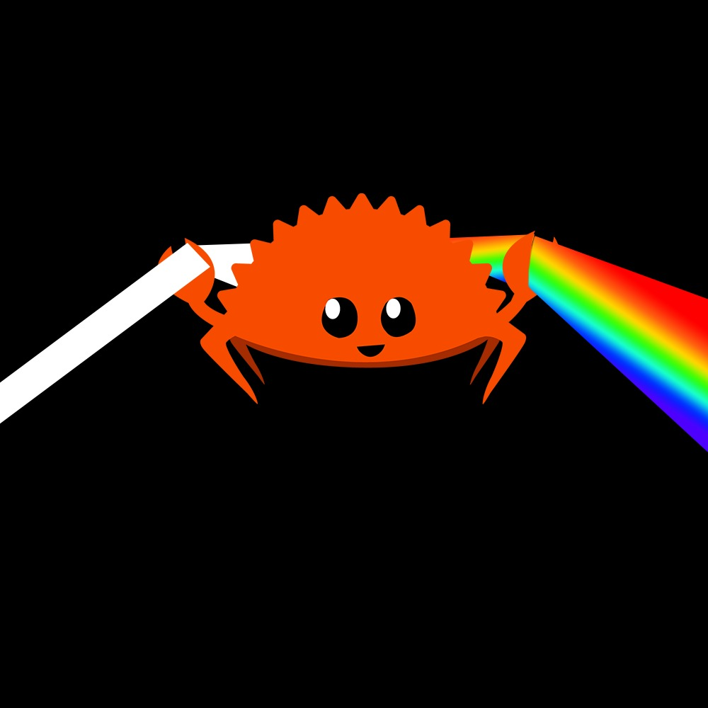
Rusterizer Masterclass “Hello Triangle!”
Luca Quartesan – quartesan.l@buas.nl – 03-10/02/2021

Slide 2
Welcome!
Feel free to ask questions at any point🙋
I will ask few questions too ⁉️
Learn Rust🦀by making a software rasterizer
Math + Code = very nice
Aspects of modern hardware rendering pipeline
Lecture 10-12, Lab 13-15
Lab with supervision feat. Traverse Research

Slide 3
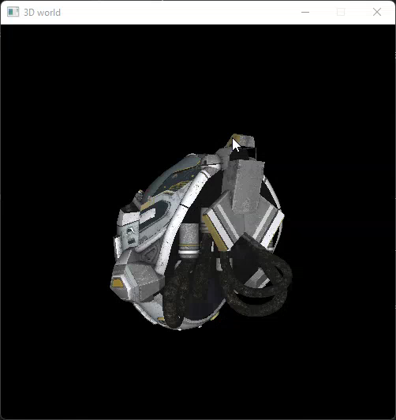
Welcome!

Slide 4
Agenda
Setup
Rasterization
Edge function
Colored triangle
Shading

Slide 5
Setup
Install Rust -> https://rustup.rs/
Install VSCode plug-ins
Rust-analyzer
Even Better TOML
Crates
C/C++ (for debugger in vscode)

Slide 6
Setup project in rust 🧑‍💻
Let’s create cargo package template
Run “cargo new 01_hello_triangle”
Let’s add some crates in “01_hello_triangle/cargo.toml”:
Minifb <= window and input
Glam <= math

Slide 7
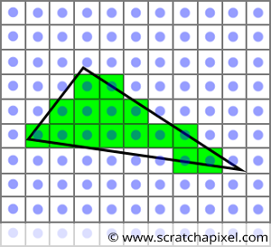
The Raster
What is a raster?
from German Raster: grid
A grid of pixels

Slide 8


Pixels 🧑‍💻
Minifb stores them as ARGB colors
ARGB32/ARGB8/A8R8G8B8
Values from 0 to 2^8=256
Still decent total amount of available colors!
Total 2^8^3 = 16 777 216
https://en.wikipedia.org/wiki/Color_space
https://docs.rs/minifb/0.25.0/minifb/struct.Window.html#method.update_with_buffer

Slide 9
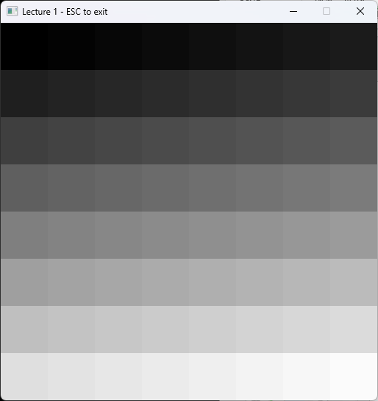
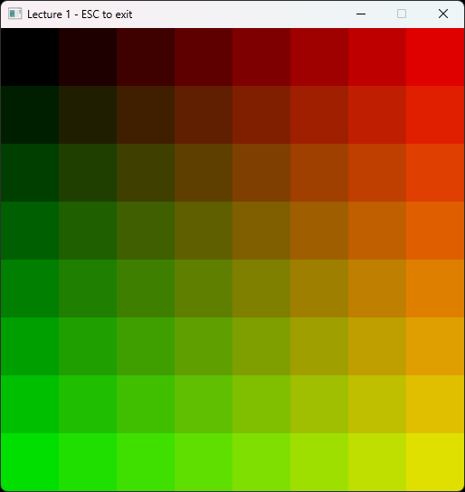
Buffer 🧑‍💻
0 | 1 | 2 | 3 | 4 | 5 | 6 | 7
8 | 9 | 10 | 11 | 12 | 13 | 14 | 15
16 | 17 | 18 | 19 | 20 | 21 | 22 | 23
24 | 25 | 26 | 27 | 28 | 29 | 30 | 31
32 | 33 | 34 | 35 | 36 | 37 | 38 | 39
40 | 41 | 42 | 43 | 44 | 45 | 46 | 47
48 | 49 | 50 | 51 | 52 | 53 | 54 | 55
56 | 57 | 58 | 59 | 60 | 61 | 62 | 63
0, 0 | 0, 1 | 0, 2 | 0, 3 | 0, 4 | 0, 5 | 0, 6 | 0, 7
1, 0 | 1, 1 | 1, 2 | 1, 3 | 1, 4 | 1, 5 | 1, 6 | 1, 7
2, 0 | 2, 1 | 2, 2 | 2, 3 | 2, 4 | 2, 5 | 2, 6 | 2, 7
3, 0 | 3, 1 | 3, 2 | 3, 3 | 3, 4 | 3, 5 | 3, 6 | 3, 7
4, 0 | 4, 1 | 4, 2 | 4, 3 | 4, 4 | 4, 5 | 4, 6 | 4, 7
5, 0 | 5, 1 | 5, 2 | 5, 3 | 5, 4 | 5, 5 | 5, 6 | 5, 7
6, 0 | 6, 1 | 6, 2 | 6, 3 | 6, 4 | 6, 5 | 6, 6 | 6, 7
7, 0 | 7, 1 | 7, 2 | 7, 3 | 7, 4 | 7, 5 | 7, 6 | 7, 7

Slide 10
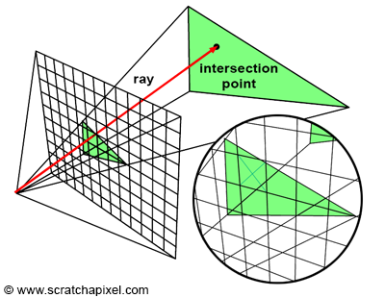
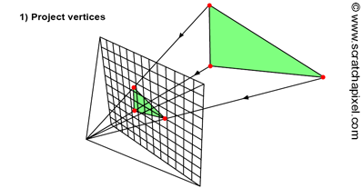
Rasterization
Rasterization vs Raytracing
object vs pixel centric
Projection vs Rays
https://www.scratchapixel.com/lessons/3d-basic-rendering/rasterization-practical-implementation/overview-rasterization-algorithm.html

Slide 11
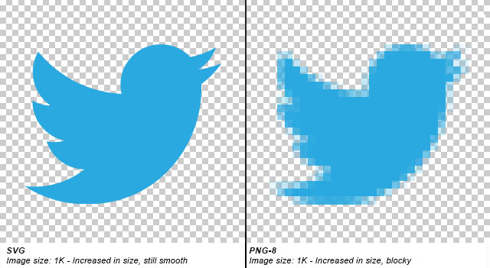
Rasterization
Rasterization consists in generating a pixel representation from:
2D shapes (e.g vector graphics)
points
lines
splines
polygons

Slide 12
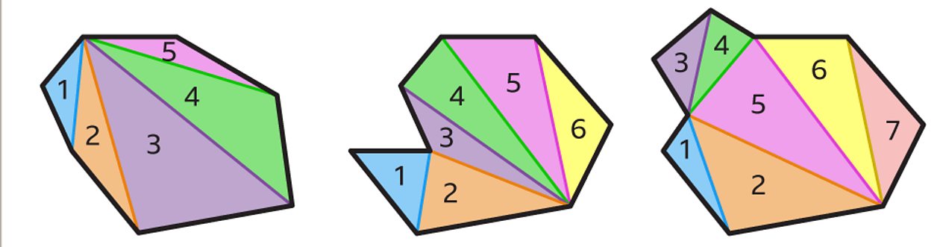
Why do we use triangles?
Triangle is the simplest 2D polygon
All polygons (convex and concaves) can be subdivided in triangles
https://www.bbc.co.uk/bitesize/topics/zdr9wmn/articles/zyg2b82

Slide 13
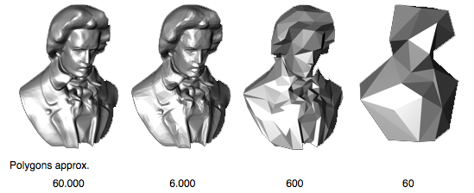
Why do we use triangles?
For 3D objects we use a collection of triangles (Mesh) which defines the surface of the object.

Slide 14
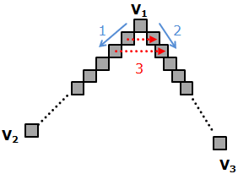
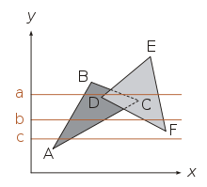
Rasterization algorithms
Which pixels should we fill?
Algorithms:
Scanline
Bresenham (lines / edges) + scanline
Edge function
http://www.sunshine2k.de/coding/java/TriangleRasterization/TriangleRasterization.html

Slide 15
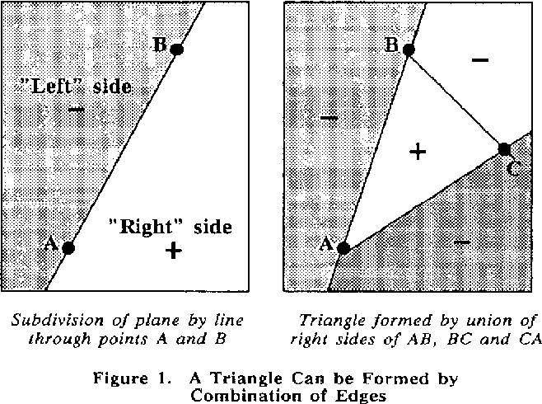
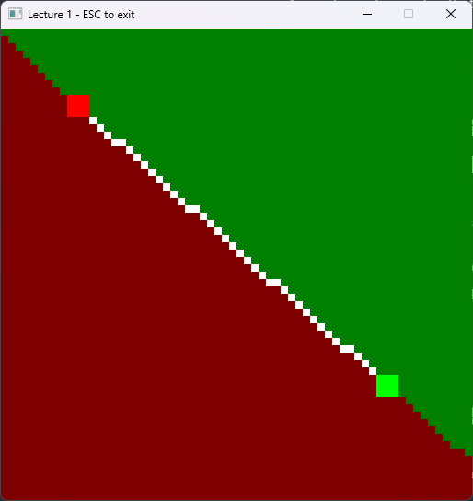
Edge Function
Pineda, J. (1988). A parallel algorithm for polygon rasterization.
given a line how can we determine on which side lays a point?

Slide 16
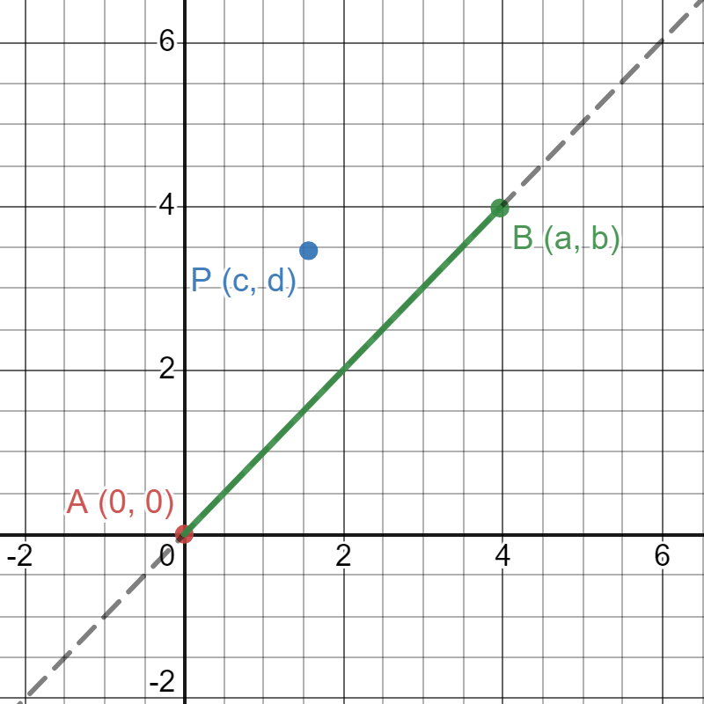
Edge Function
For a point P(c,d)
and a line passing by two points:
A(0,0)
B(a,b)
https://www.desmos.com/calculator/zofpet5j75

Slide 17
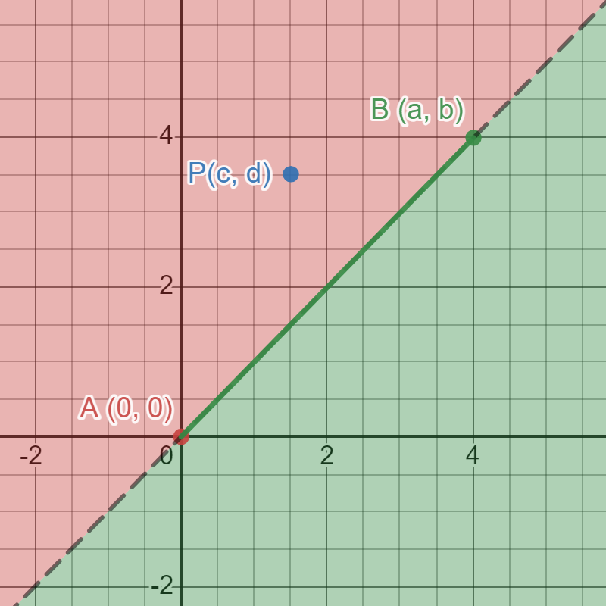
Edge Function
For a point P(c,d)
and a line passing by two points:
A(0,0)
B(a,b)
We want to know on which side P is w.r.t. the line passing by AB
https://www.desmos.com/calculator/7jdtgkoh1d

Slide 18
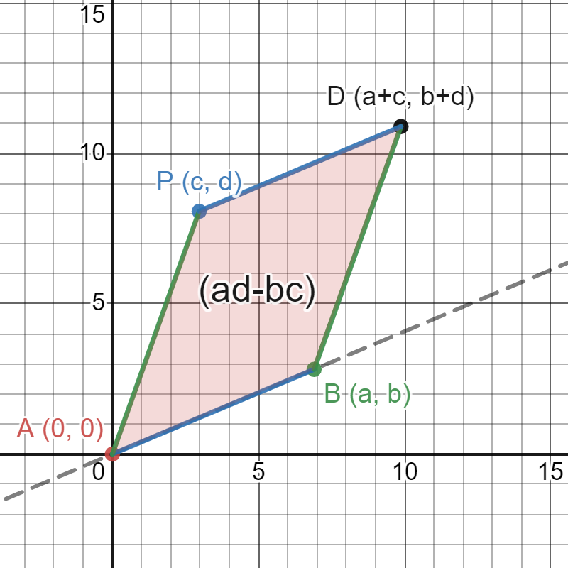

Edge Function
We can use the determinant
Determinant:
the determinant gives us the signed area of the parallelogram
$$det\left(\begin{matrix}a & c \\ b & d\end{matrix}\right)=\left|\begin{matrix}a & c \\ b & d\end{matrix}\right|=ad−bc$$
https://www.desmos.com/calculator/nb6yovy1dv

Slide 19
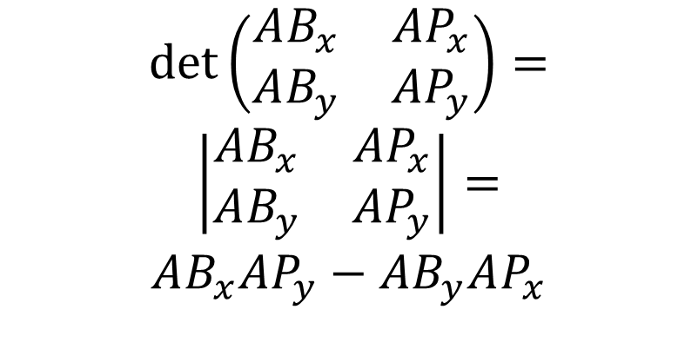
Edge Function
For a point P and a line passing by two points A and B
$$det\left(\begin{matrix}AB_{x} & AP_{x} \\ AB_{y} & AP_{y}\end{matrix}\right)=$$
$$\left|\begin{matrix}AB_{x} & AP_{x} \\ AB_{y} & AP_{y}\end{matrix}\right|=$$
$$AB_{x}AP_{y}−AB_{y}AP_{x}$$
https://www.desmos.com/calculator/nb6yovy1dv

Slide 20
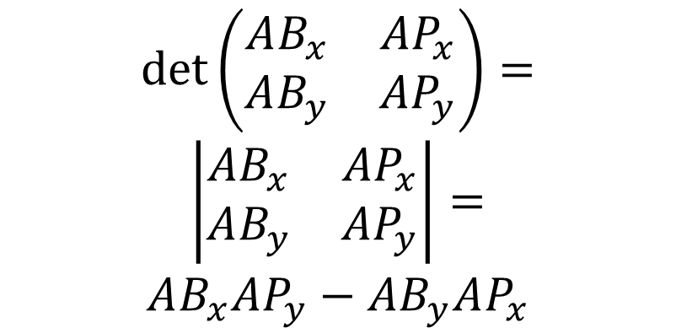
Edge Function
The signed area is negative when the angle from the first to the second vector turns in a clockwise direction
$$det\left(\begin{matrix}AB_{x} & AP_{x} \\ AB_{y} & AP_{y}\end{matrix}\right)=$$
$$\left|\begin{matrix}AB_{x} & AP_{x} \\ AB_{y} & AP_{y}\end{matrix}\right|=$$
$$AB_{x}AP_{y}−AB_{y}AP_{x}$$
https://www.desmos.com/calculator/nb6yovy1dv

Slide 21
Edge Function
Pineda, J. (1988). A parallel algorithm for polygon rasterization.
How is it parallel?
Pixels can run independently

Slide 22
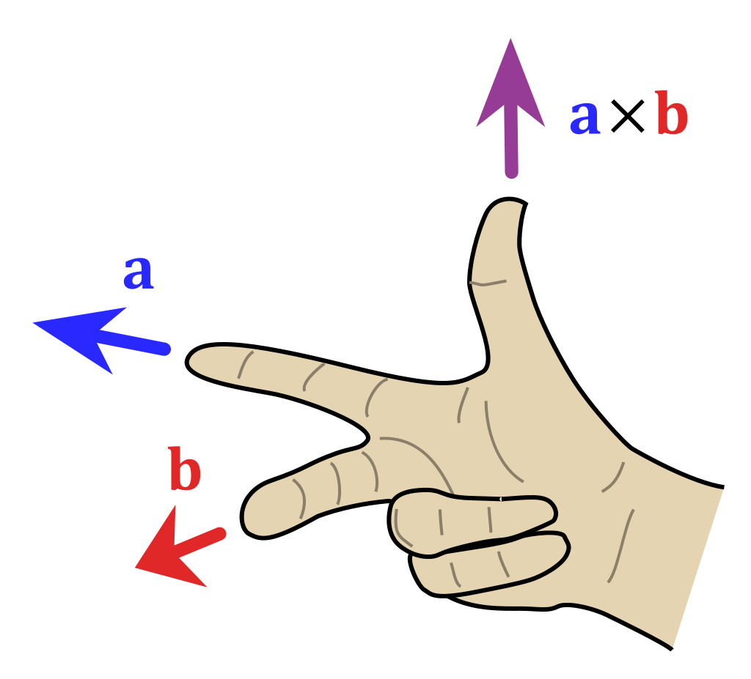
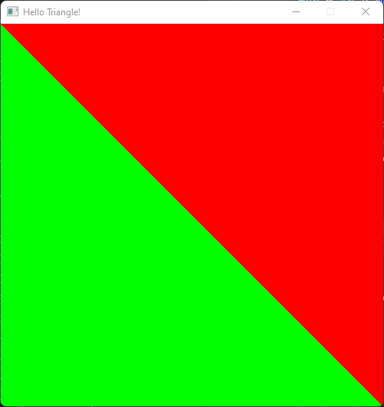
Edge Function🧑‍💻
Does anyone know of another way of calculating on which side of a line a point lies?

Slide 23
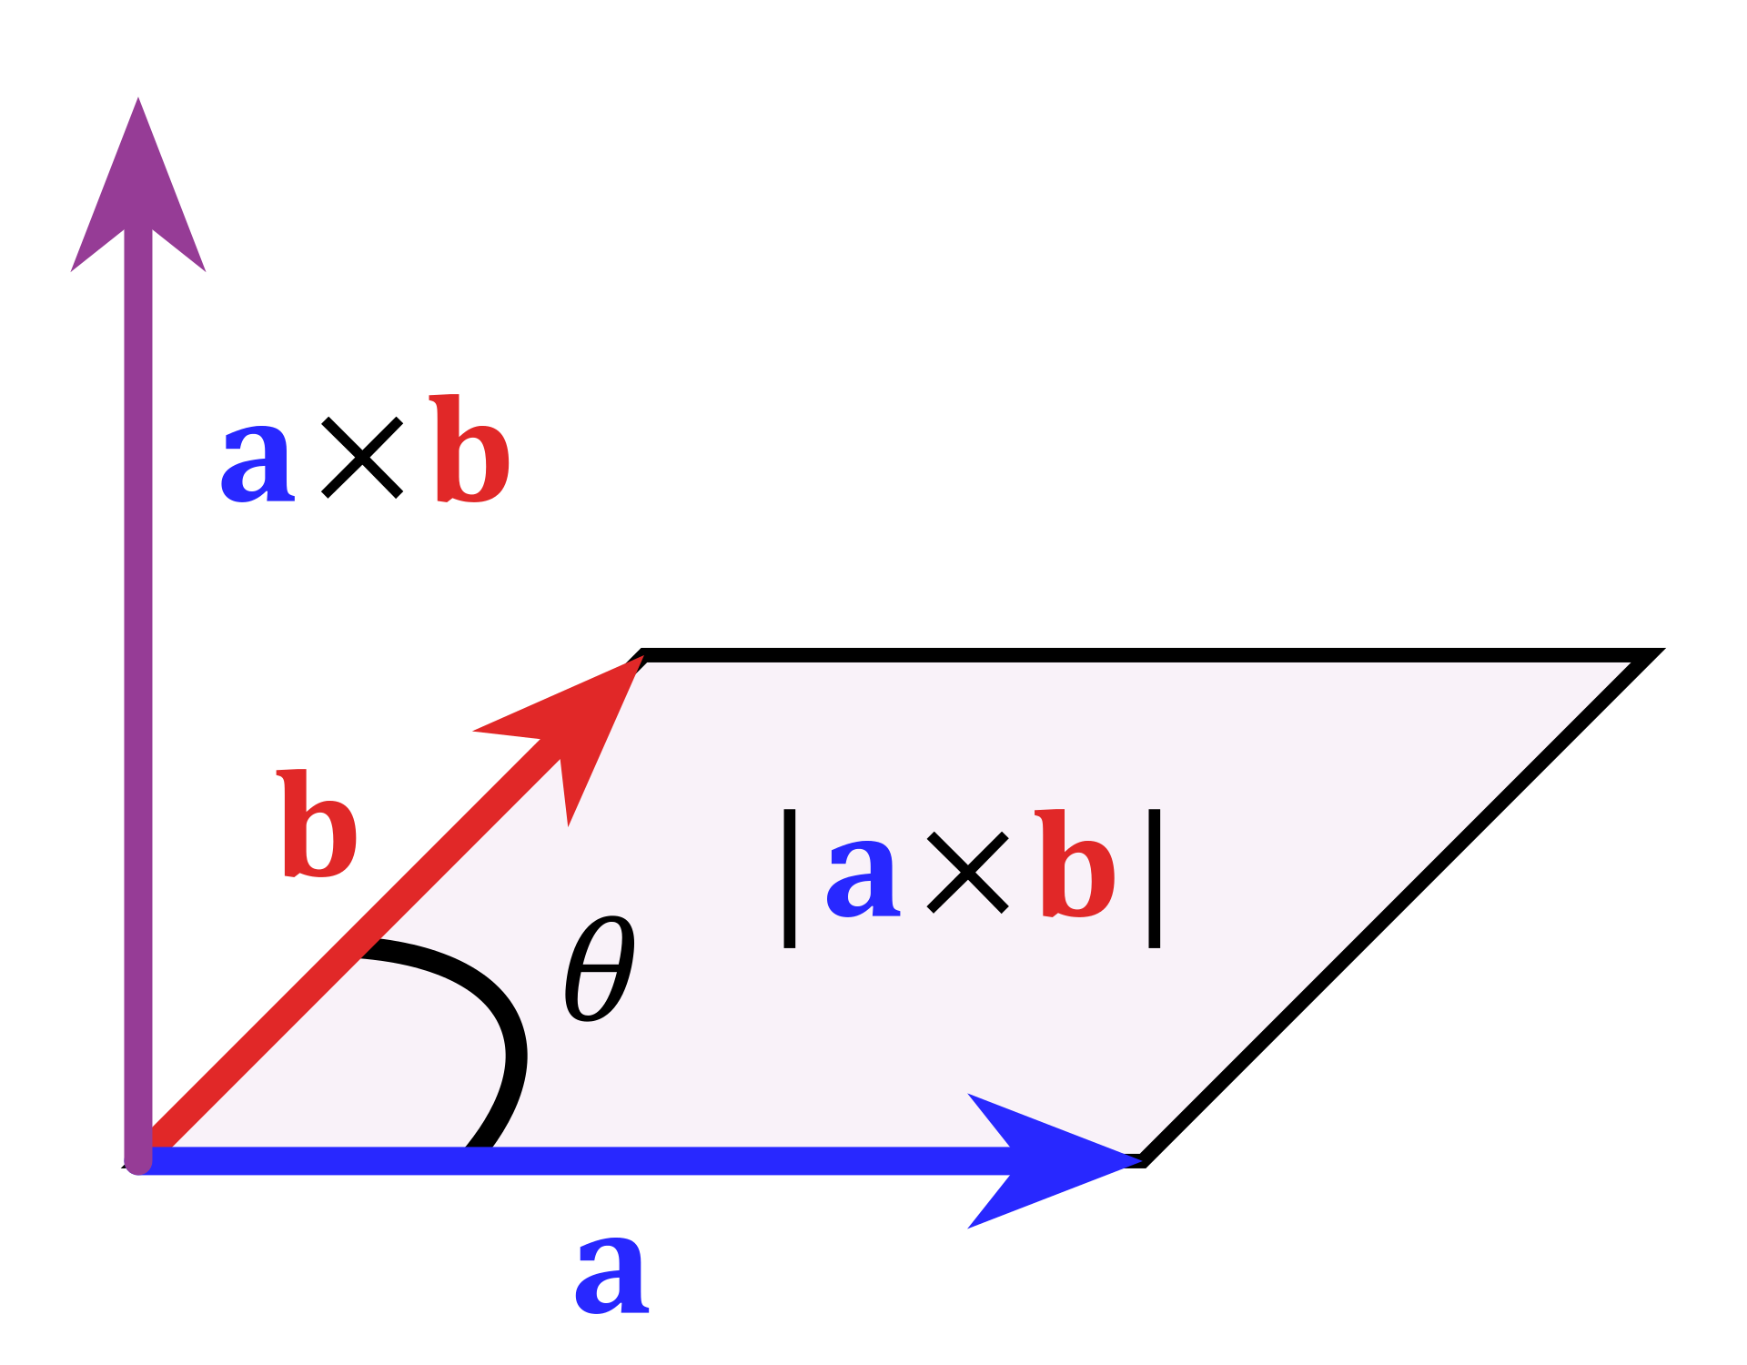
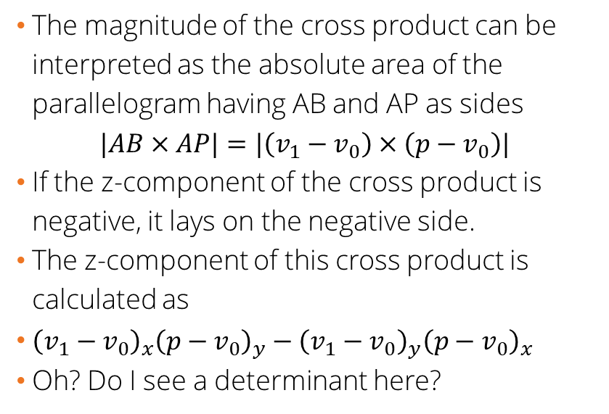
Edge Function – cross product
The magnitude of the cross product can be interpreted as the absolute area of the parallelogram having AB and AP as sides $|AB×AP|=|\left(v_{1}−v_{0}\right)×\left(p−v_{0}\right)|$
If the z-component of the cross product is negative, it lays on the negative side.
The z-component of this cross product is calculated as
${\left(v_{1}−v_{0}\right)}_{x}{\left(p−v_{0}\right)}_{y}−{\left(v_{1}−v_{0}\right)}_{y}{\left(p−v_{0}\right)}_{x}$
Oh? Do I see a determinant here?
https://en.wikipedia.org/wiki/Cross_product

Slide 24
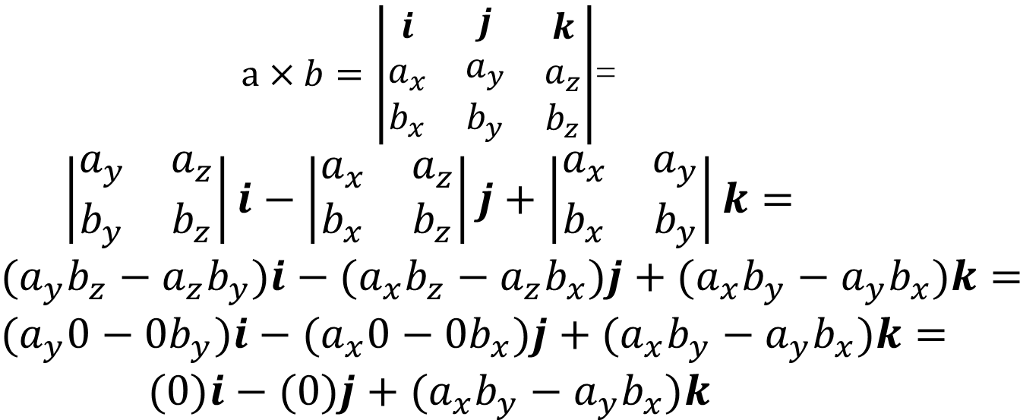
Edge Function – cross product
$a×b=\left|\begin{matrix}\begin{matrix}i \\ a_{x} \\ b_{x}\end{matrix} & \begin{matrix}j \\ a_{y} \\ b_{y}\end{matrix} & \begin{matrix}k \\ a_{z} \\ b_{z}\end{matrix}\end{matrix}\right|$=
$$\left|\begin{matrix}a_{y} & a_{z} \\ b_{y} & b_{z}\end{matrix}\right|i−\left|\begin{matrix}a_{x} & a_{z} \\ b_{x} & b_{z}\end{matrix}\right|j+\left|\begin{matrix}a_{x} & a_{y} \\ b_{x} & b_{y}\end{matrix}\right|k=$$
$$(a_{y}b_{z}−a_{z}b_{y})i−(a_{x}b_{z}−a_{z}b_{x})j+(a_{x}b_{y}−a_{y}b_{x})k=$$
$$(a_{y}0−0b_{y})i−(a_{x}0−0b_{x})j+(a_{x}b_{y}−a_{y}b_{x})k=$$
$$(0)i−(0)j+(a_{x}b_{y}−a_{y}b_{x})k$$

Slide 25
Edge function – Triangles
So now that we can determine on which side of line we are, how do we apply this to triangles?

Slide 26
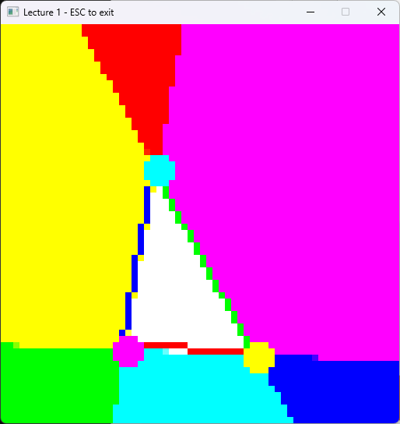
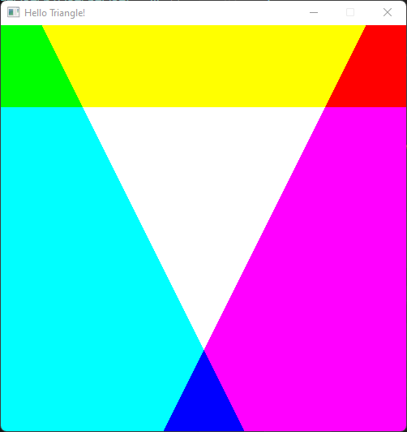
Edge Function – Triangles 🧑‍💻
A triangle has 3 edges => we need to compute 3 edge functions one per edge
If all positive then the point is inside the triangle
Pineda, J. (1988). A parallel algorithm for polygon rasterization.

Slide 27
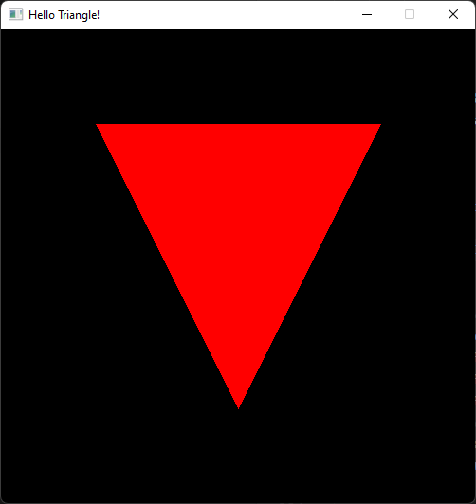
Thank you!
Any Question?

Slide 28
Resources
Rasterization: a Practical Implementation
Optimizing Software Occlusion Culling – index | The ryg blog
Texture Mapping & Polygon Rasterizing Tutorial (1/2) [C++20] – YouTube
3D Programming Fundamentals [Introduction] Tutorial 0 – YouTube
Rasterizer Algorithm Explanation - YouTube

Slide 29
You could try 🔬
Draw circles
Draw lines (Bresenham's line algorithm)
Bresenham + scanline
Draw polygons
Implement input

